Slide 1

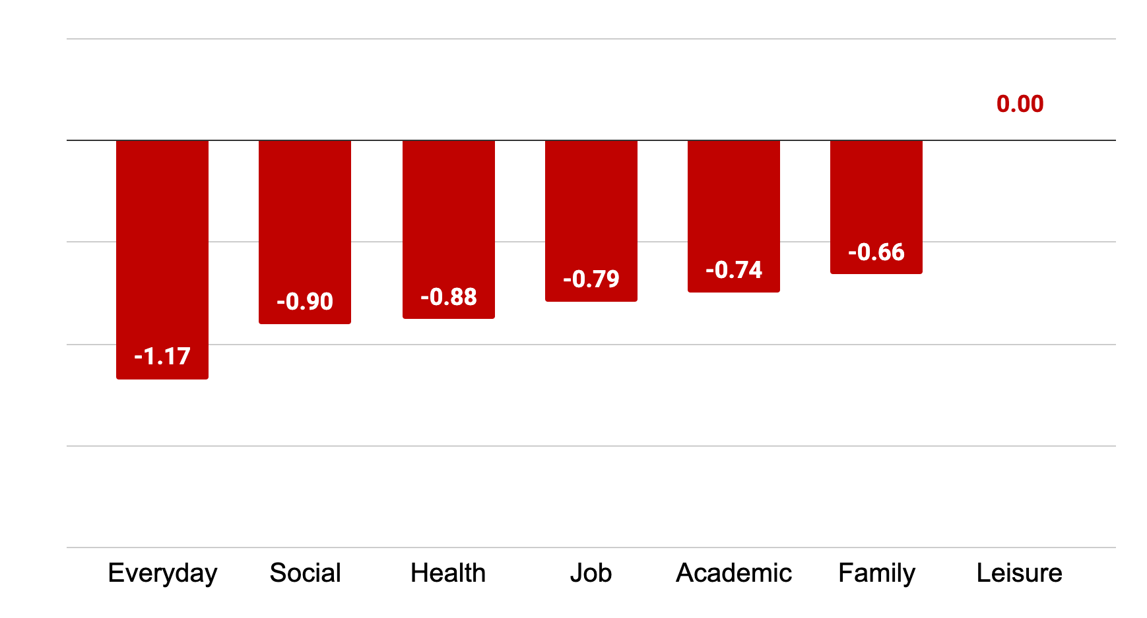
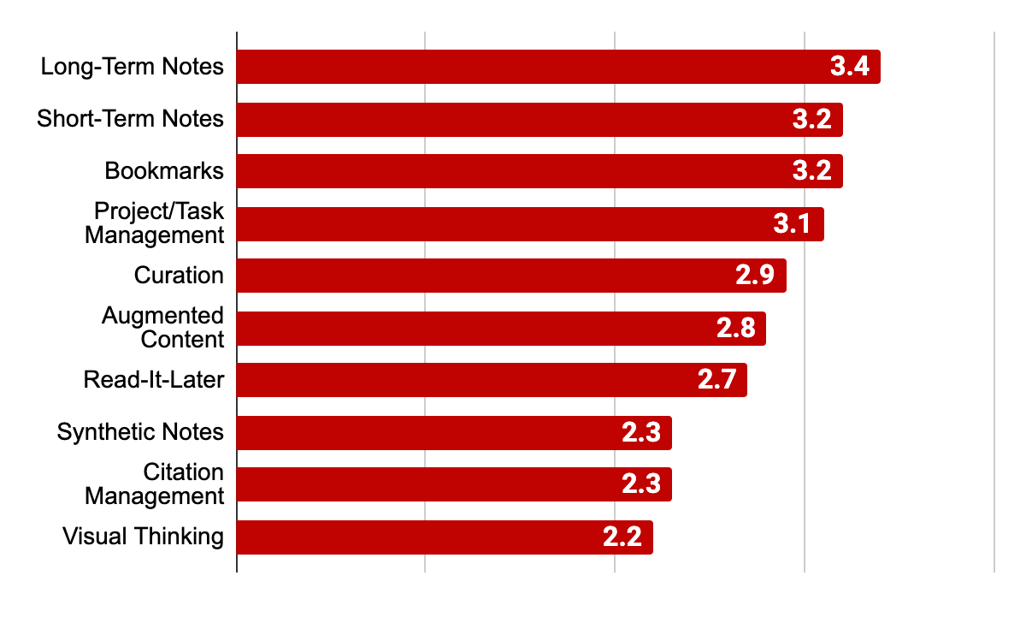
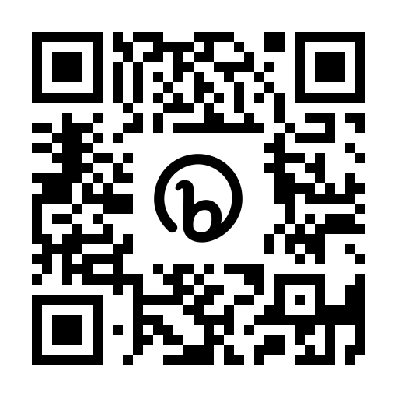
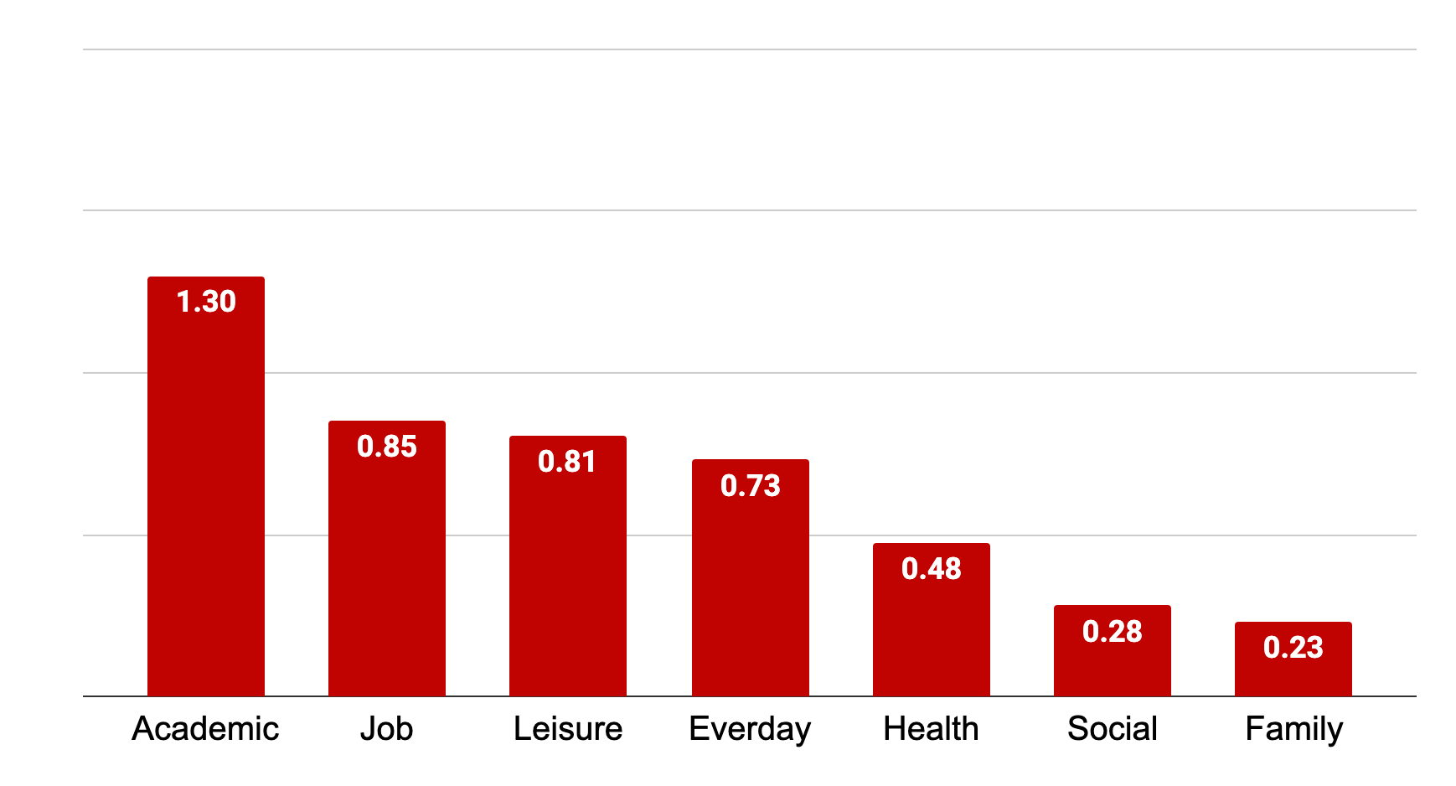
Personal Knowledge Management of Neurodivergent Students
Kelly M. Hoffman, College of Information Studies
Introduction
PKM positively affects neurodivergent students’ academic life, most commonly through long- and short-term notes, web bookmarks, and task management.
How does your neurodivergence affect your
quality of life in the following areas?
Neurodivergence is an umbrella term that includes a wide variety of conditions that are considered atypical. Neurodivergent conditions commonly found on college campuses include ADHD, autism, dyslexia, dyspraxia, and Tourette Syndrome.
Neurodivergence is often correlated with poorer-than-average academic outcomes (Arnold et al., 2020; Bolourian et al., 2018; Flores et al., 2022; and countless others).
Personal Knowledge Management (PKM) is a set of “collection processes that an individual needs to carry out in order to gather, classify, store, search, and retrieve knowledge in [their] daily activities” (Razmerita et al., 2009).
Anecdotal evidence in online communities suggests that PKM may be helpful to neurodivergent individuals across many different life domains.
no effect
somewhat negatively
extremely negatively
How often do you engage in the
following types of PKM?
Methods
Anonymous online survey
  6 close-ended questions
  5 open-ended questions
Participants self-identified as neurodivergent
Student participants: N = 82 (39 graduate, 35 undergraduate)
  Full study participants: N = 304
37 students with ADHD, 15 students with autism
16 AuADHD students (10 undergraduates, 6 gradaute)
Open-ended questions were analyzed using thematic analysis (Braun & Clarke, 2006)
The analysis presented on this poster represents the subset of survey participants who indicated that they were students (graudate or undergradaute).
Take a picture for a copy of this poster and additional information, or visit ndpkm.com
never heard of it
only
heard of it
a little
sometimes
frequently
How do your PKM activities affect your
quality of life in the following areas?
Cohort 2
Key References
extremely positively
Arnold, L. E., Hodgkins, P., Kahle, J., Madhoo, M., & Kewley, G. (2020). Long-term outcomes of ADHD: Academic achievement and performance. Journal of Attention Disorders, 24(1), 73–85.
Bolourian, Y., Zeedyk, S. M., & Blacher, J. (2018). Autism and the University Experience: Narratives from Students with Neurodevelopmental Disorders. Journal of Autism and Developmental Disorders, 48(10), 3330–3343.
Braun, V., & Clarke, V. (2006). Using thematic analysis in psychology. Qualitative Research in Psychology, 3(2), 77–101.
Flores, J., Caqueo-Urízar, A., López, V., & Acevedo, D. (2022). Symptomatology of attention deficit, hyperactivity and defiant behavior as predictors of academic achievement. BMC Psychiatry, 22(1), Article 1.
Razmerita, L., Kirchner, K., & Sudzina, F. (2009). Personal knowledge management: The role of Web 2.0 tools for managing knowledge at individual and organisational levels. Online Information Review, 33(6), 1021–1039.
somewhat positively
no effect

